Slide 1



Hidden Patterns in Bird Songs
Navyanth Kusampudi

Slide 2
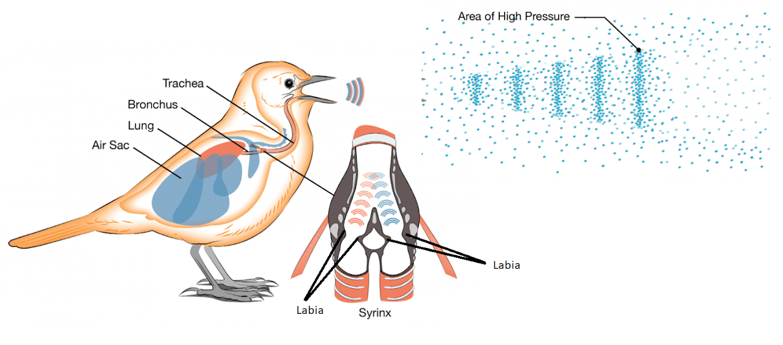

Mechanism of Song Production

Slide 3
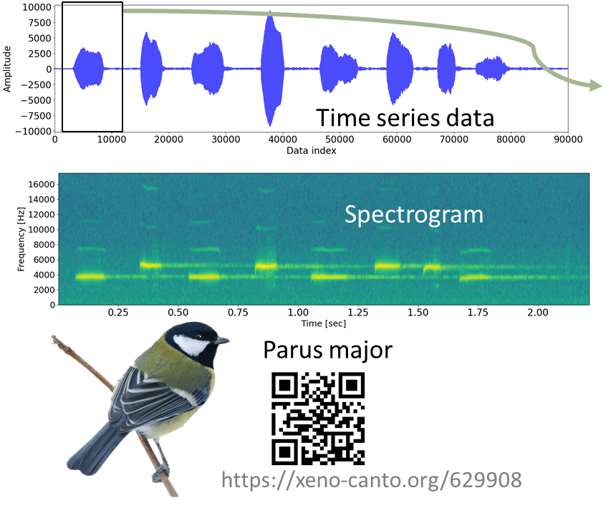
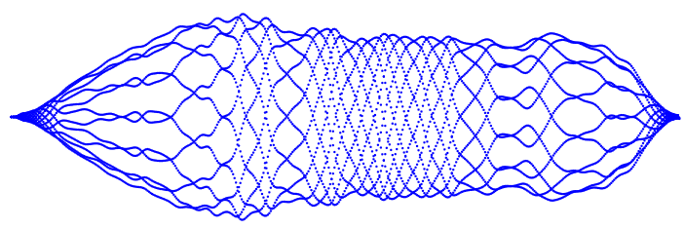
Bird Song Analysis (conventional methods)
Hidden patterns inside single chirp of bird song

Slide 4
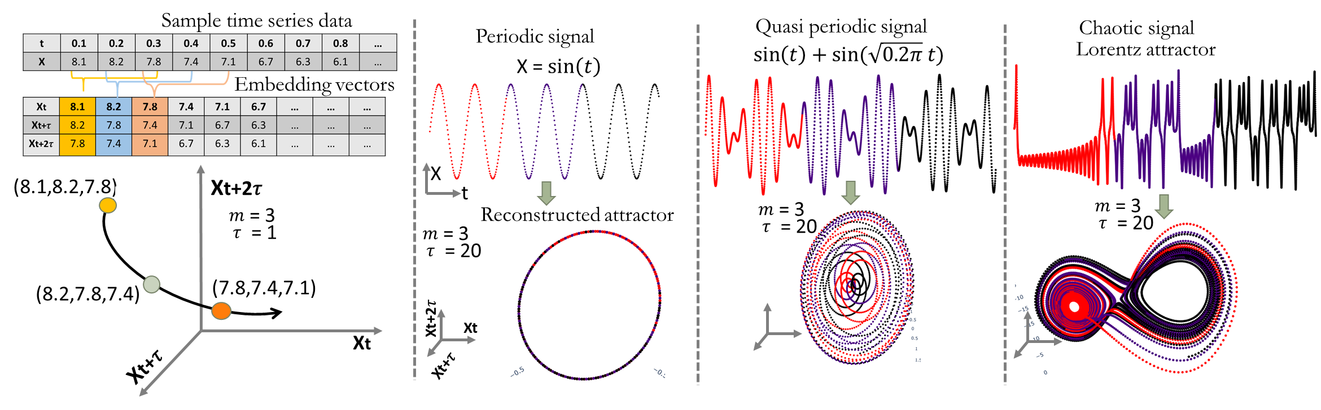
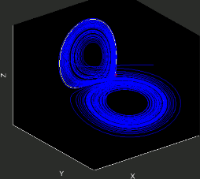
Method: Time delay embedding of signal

Slide 5
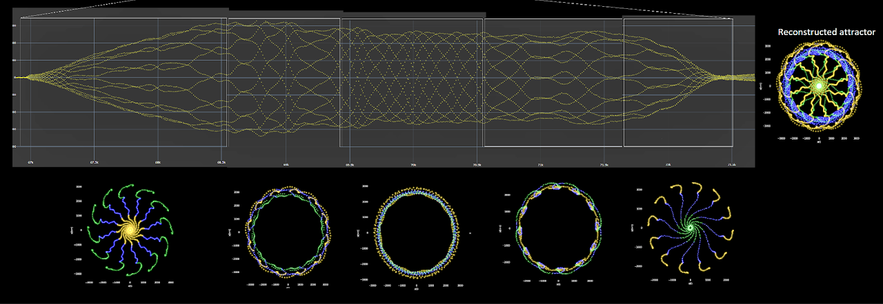
Bird Song Analysis (current method: Time delay embedding)
Variations inside a single chirp can be identified which were not possible with the previous analysis techniques

Slide 6
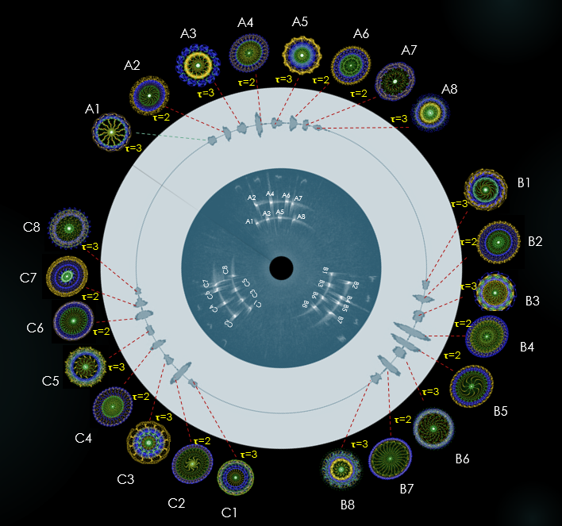
Patterns from Same Bird Song
Are there any repetitions ?
Why so much variation in a same song from same bird ?

Slide 7
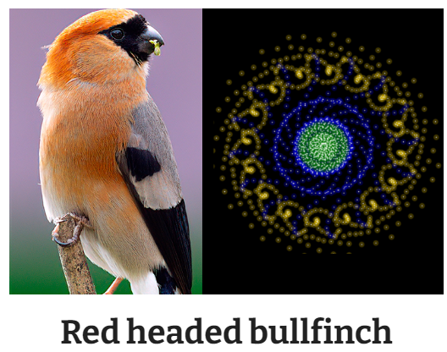

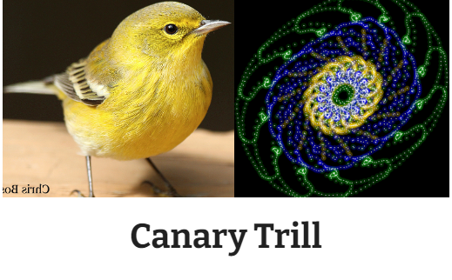

Patterns from Other Bird Songs

Slide 8
Summary
Variations inside a single chirp can be identified which were not possible with the previous analysis techniques
But what do these patterns mean? Physical mechanism?
How to quantify these patterns?
Can you identify similar patterns in the same bird species?

